Slide 2
easyCBM: Skills-Based Baseline/Progress Monitoring Tool
Skills-based baseline assessments
Administered to those student who were identified for progress monitoring by NWEA MAP assessment. Also administered to students receiving special education (excluding students in self-contained classes and gifted only). The baseline probe(s) are administered at the student's enrolled grade level.
Progress Monitoring
Brief assessments administered at student's instructional level to individuals or small groups of students receiving support to determine response to instruction/intervention

Slide 3
Step 1: Student take easyCBM Benchmark tests For easyCBM Benchmark tests taken online: Students select Click here from the log in screen

Slide 4
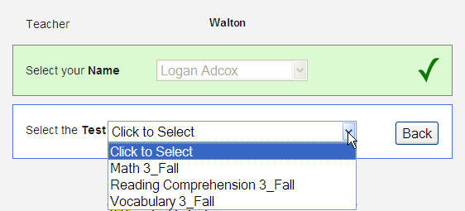
Students type in their teacher’s user name, then select their name and the test to take:

Slide 5
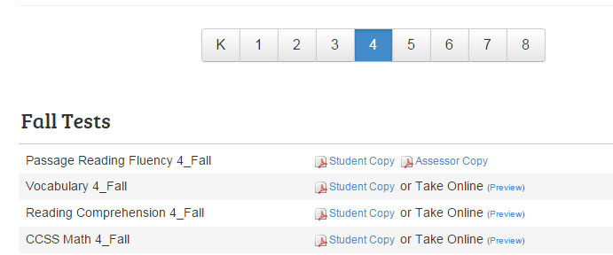
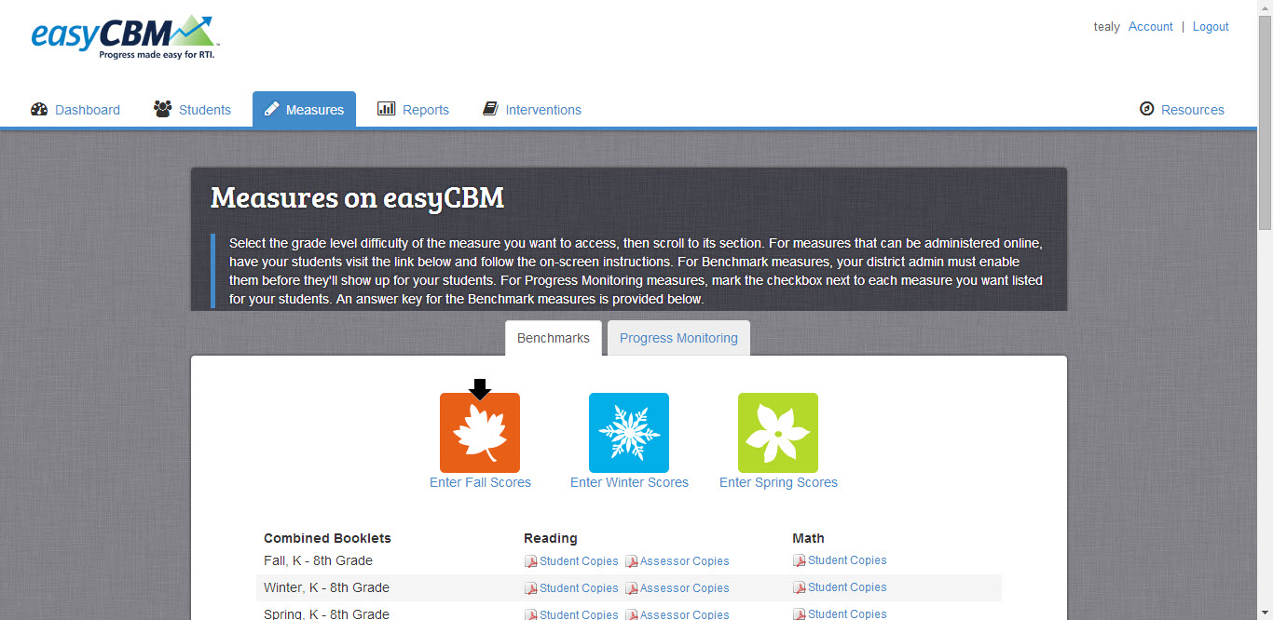
To administer fluency measures:
Teacher logs in
From the Measures tab, the teacher prints out student copy of fluency test to be administered
Teacher clicks Enter Fall Scores

Slide 6
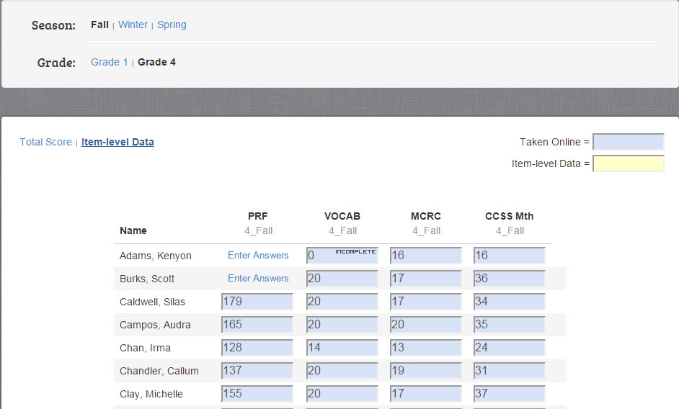
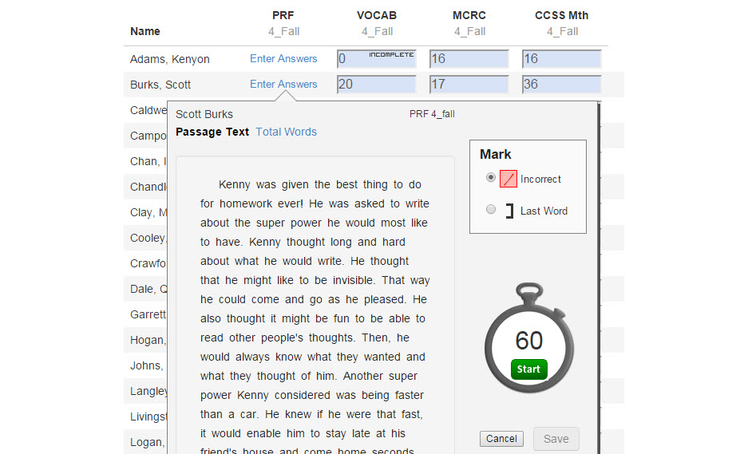
To administer Benchmark fluency measures (con’t):
The teacher then clicks Item Level Data
The teacher then clicks Enter Answers
The teacher can then record errors as student is reading
Click Save

Slide 7
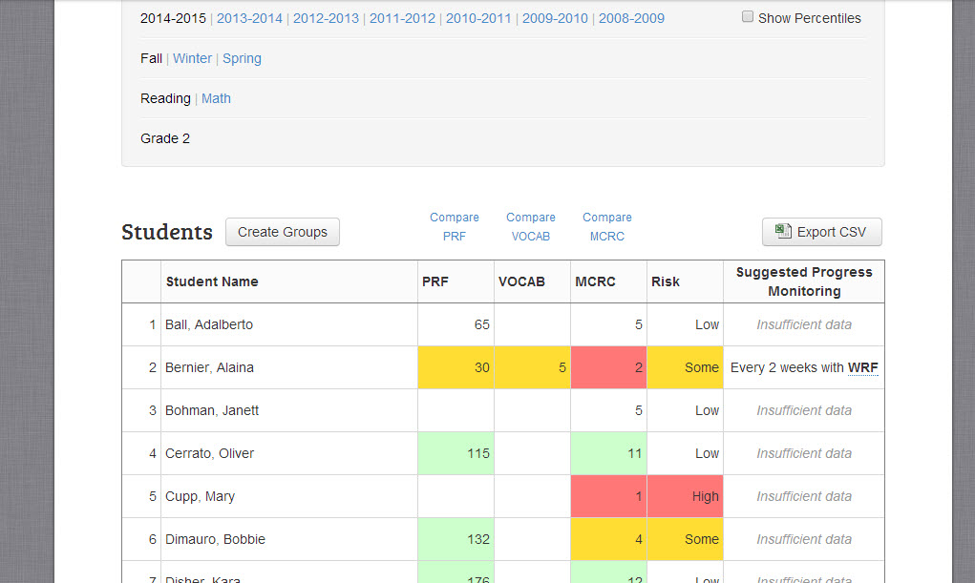
Step 2: Review Skills-Based Assessment Test Results:

Slide 8
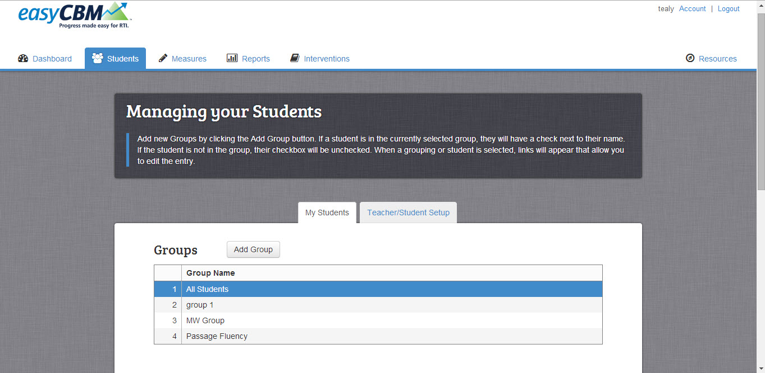
Step 3: Use information on student performance to create intervention groups in easyCBM
Groups can be created by teachers from the Benchmark Report
Groups can be created from the Students tab

Slide 9
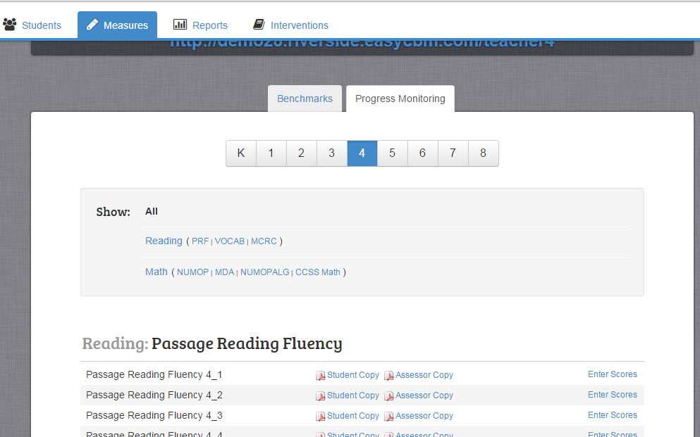
Progress Monitoring assessments (con’t)
To administer fluency tests, print a copy for the student(s) and then select Enter Scores

Slide 10
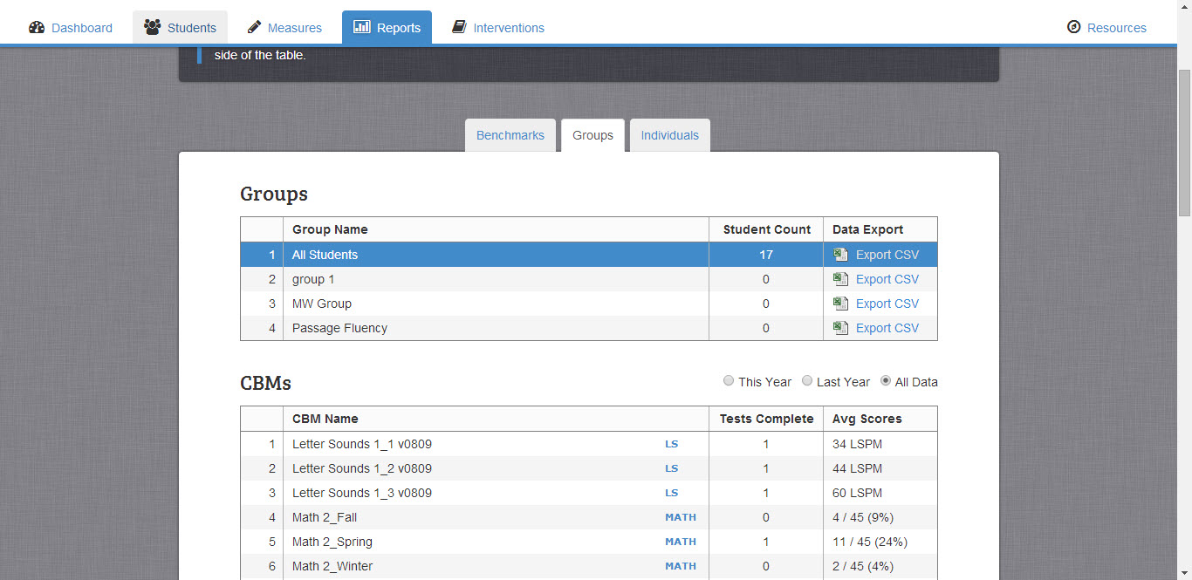
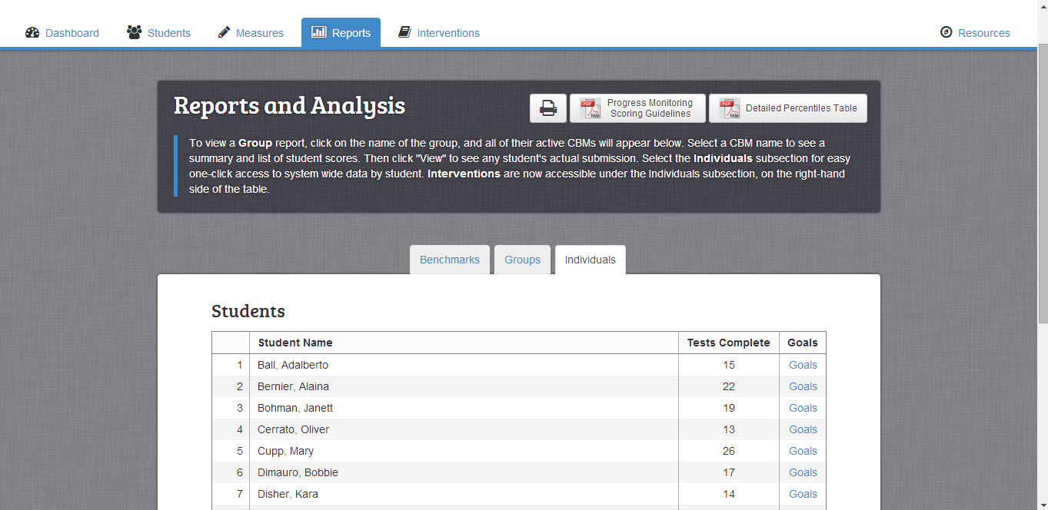
Step 5: View results from Progress Monitoring tests from Group and/or Individuals tabs under Reports

Slide 11
Resources

Slide 12
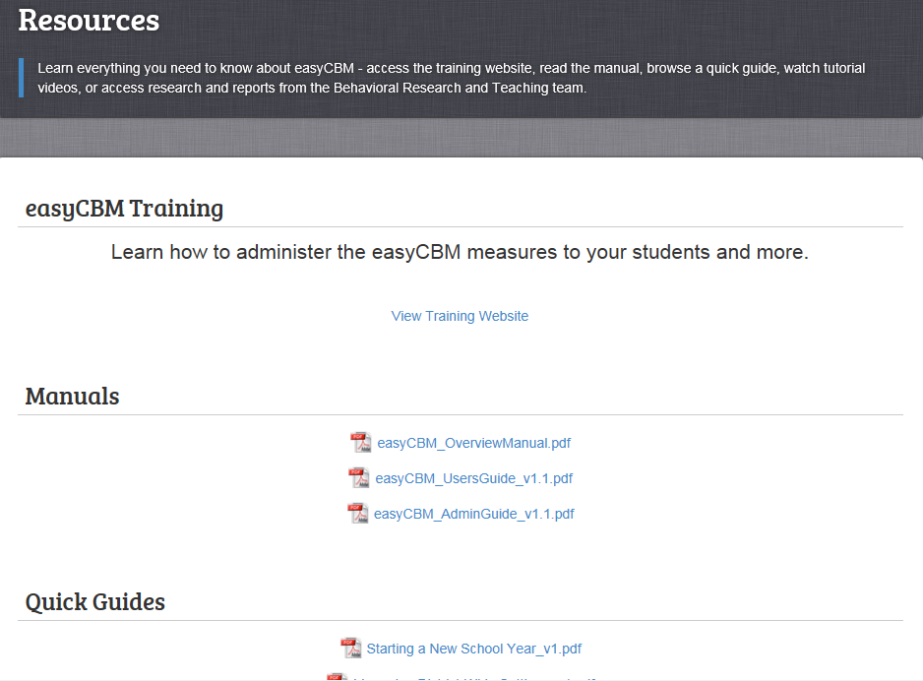
Resources

Slide 13
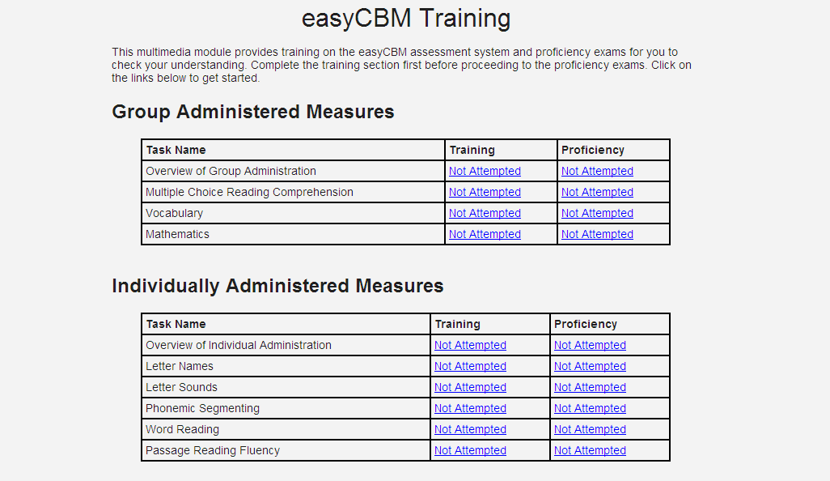
Training
Teachers can practice scoring to ensure proficiency across measures.

Slide 14
Training
Training sections
for individually-administered measures include video clips

Slide 15
Resources

