Slide 1


FACE Department
Parent Led Organizations

Slide 2




FACE Contact Information
Address: 160 S. Hollywood St, Rm 164
Phone: 416-7600
Website: http://www.scsk12.org/face/
Email: scsface@scsk12.org
Social Media:
@EmpowerSCS
@FACESCS
@FACESCS

Slide 3

LEARNING OUTCOMES
Smaller Title or Accent Image Here
Identify the District’s approval process for parent organizations
Identify the type of parent organizations recognized by the District
Identify the role and why parent organizations are important to our schools
Identify resources for school staff and parent groups

Slide 4
Parent Organizations Are Important!
Smaller Title or Accent Image Here
Support the educational programs and extracurricular activities of the school
Encourage parents’ involvement in their individual children’s lives, education, class, and school
Provide feedback and suggestions for school programs

Slide 5
Parent Organizations Are Important!
Organize fundraising efforts to support additional programs, equipment, and services not covered in the school budget
Smaller Title or Accent Image Here

Slide 6
Types of Parent Organizations
Booster Clubs
Parent Organizations
An organized volunteer group of parents, adult community members, and/or staff authorized by the District to provide fundraising and other services in support of a school-recognized club, sports team, band, or organization
An organized volunteer group of parents authorized by the District whose primary purpose is to promote the entire school through organized efforts and activities

Slide 7
What’s The Difference?
Smaller Title or Accent Image Here
Parent Teacher
Organization (PTO)
Parent Teachers
Association (PTA)
Parent Teacher Student
Association (PTSA)
Not part of a national network and not required to pay dues to a state or national organization
Can focus on issues that relate to the community and school
Provides volunteer opportunities to support schools
A national headquarters
Local PTAs pay dues to a national office; may join a national initiative; advocate for schools
Has a broader mission of advocating for children; utilizes state and national networks
Local PTA’s have access to resources and partnerships
Not part of a national network and not required to pay dues to a state or national organization
Can focus on issues that relate to the community and school
Students are permitted and encouraged to hold leadership roles

Slide 8
Quick Recap
Importance of parent organization to the ecosystem or our schools
Role of parent groups
Differences (name & type) between parent organizations and booster clubs

Slide 9
Family Engagement Policy (7009)
Each school shall be required to have a parent organization that may include, but is not limited to a Parent Teacher Association (PTA); Parent Teacher Student Association (PTSA); Parents (Partners) in Education (PIE); and Parent Teacher Organization (PTO)
Parent organizations MUST register annually

Slide 10
Family Engagement Policy (7009)
Each school shall be required to have a parent organization that may include, but is not limited to a Parent Teacher Association (PTA); Parent Teacher Student Association (PTSA); Parents (Partners) in Education (PIE); and Parent Teacher Organization (PTO)

Slide 11
SSOs Defined by SCS Policy (7007)
A group of persons who merely request that students, parents, or members of the general public make donations to a school district, school, school club, or academic, arts, athletic, or social activity related to a school or assist in the raising of funds for a specified purpose under the sponsorship of a school employee where the funds are turned over to the school to be used for the specific purpose for which the funds were raised, shall not be considered a school support organization

Slide 12
SSOs Defined by SCS Policy (7007)
A nongovernmental organization or group of persons whose primary purpose is to support a school district, school, school club, or academic, arts, athletic, or social activities related to a school which collects or receives money, materials, property or securities from students, parents, or members of the general public

Slide 13


Docs Required for a First Time SSO
PTO
PTSA
PTA
BOOSTER
Proof of current Tennessee Non-profit Corporation or charitable foundation status
Goals and objectives of the organization
Cooperative Agreement

Slide 14
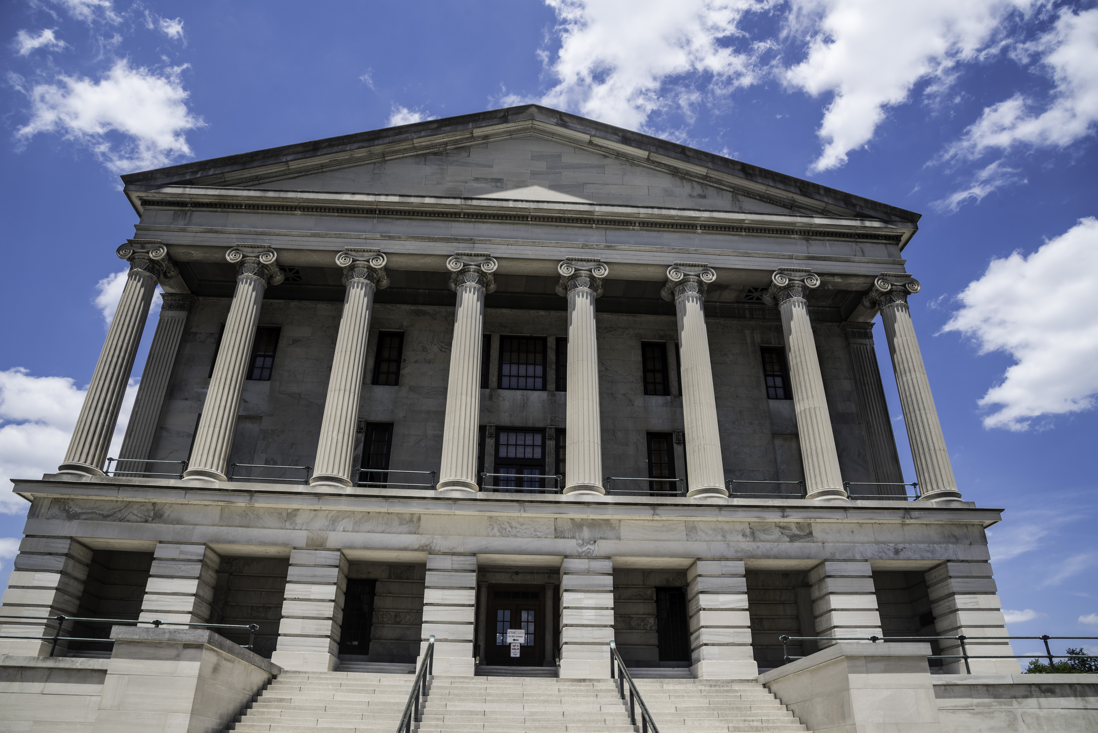
Tennessee Non-Profit
Corporation

Slide 15
Charitable Foundation

Slide 16
Annual Report: TN Non-Profit Corporation

Slide 17
Docs Required for Returning SSO
Proof of Tennessee Nonprofit Corporation or charitable foundation status
Goals and objectives of the organization
Cooperative Agreement
A statement of total revenues and disbursements - previous school year
Copy of minutes of meetings (first, mid-year & last meeting)
PTO
PTSA
PTA
BOOSTER

Slide 18

Annual Financial Report

Slide 19

Meeting Minutes

Slide 20
Prohibited Activity
p
ll
School representatives are not allowed to be the organization’s treasurer, bookkeeper, and/or signatory of checks
A majority of the voting board members cannot be composed of School Representatives
Using the school's or school district's sales tax exemption to purchase items
Using SSO funds for a purpose other than related to the goals and objectives of the SSO that relate to supporting a school district, school, school club or school academic, arts, athletic, or social activity

Slide 21
Prohibited Activity
Representing or imply that its activities, contracts, purchases, or financial commitments are made on behalf of or binding upon the school or school district
Maintaining or operating a bank account that bears the Employer Identification Number (EIN) of a school board, school, or any other school related governmental entity
SSOs are prohibited from any activity until approved by the District

Slide 22
Parent Organization Registration Portal
https://sso.scsk12.org/

Slide 23
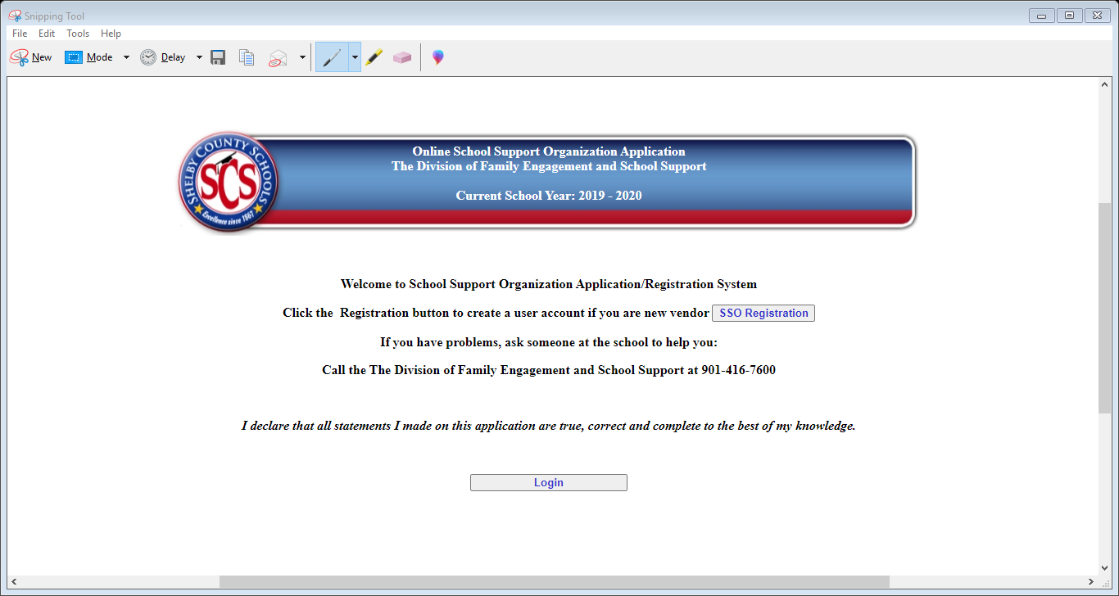

Slide 24
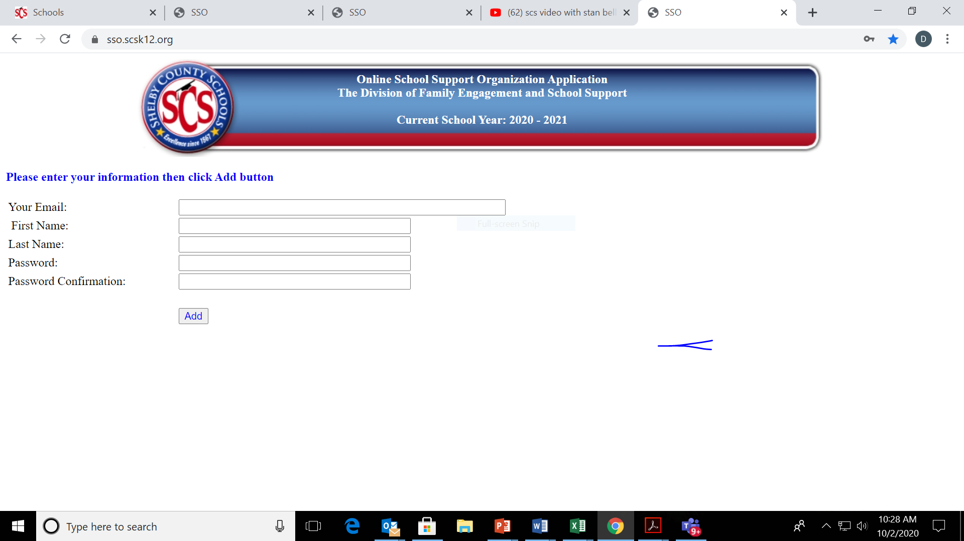

Slide 25
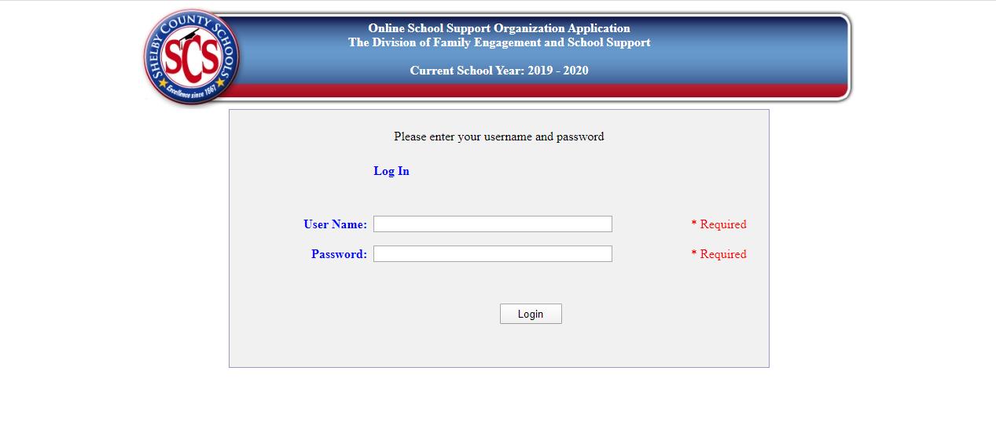
Enter your email address

Slide 26
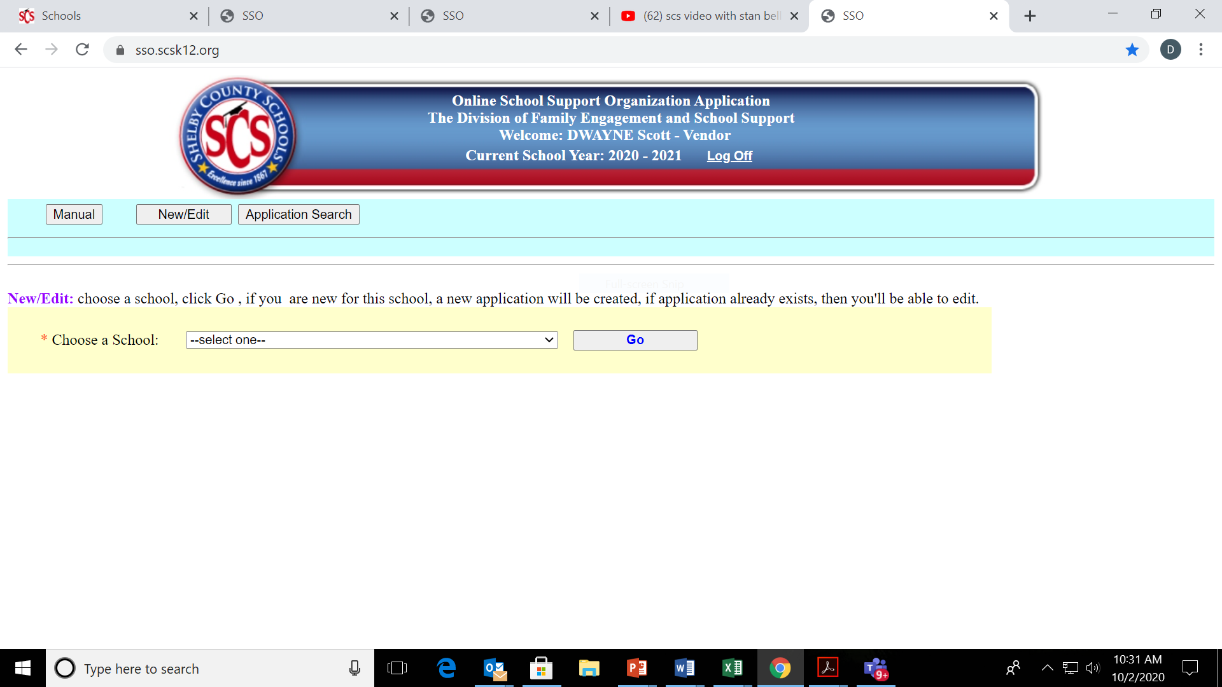

Slide 27
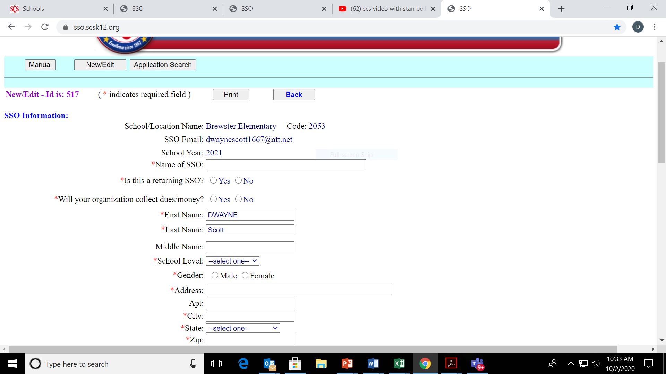

Slide 28
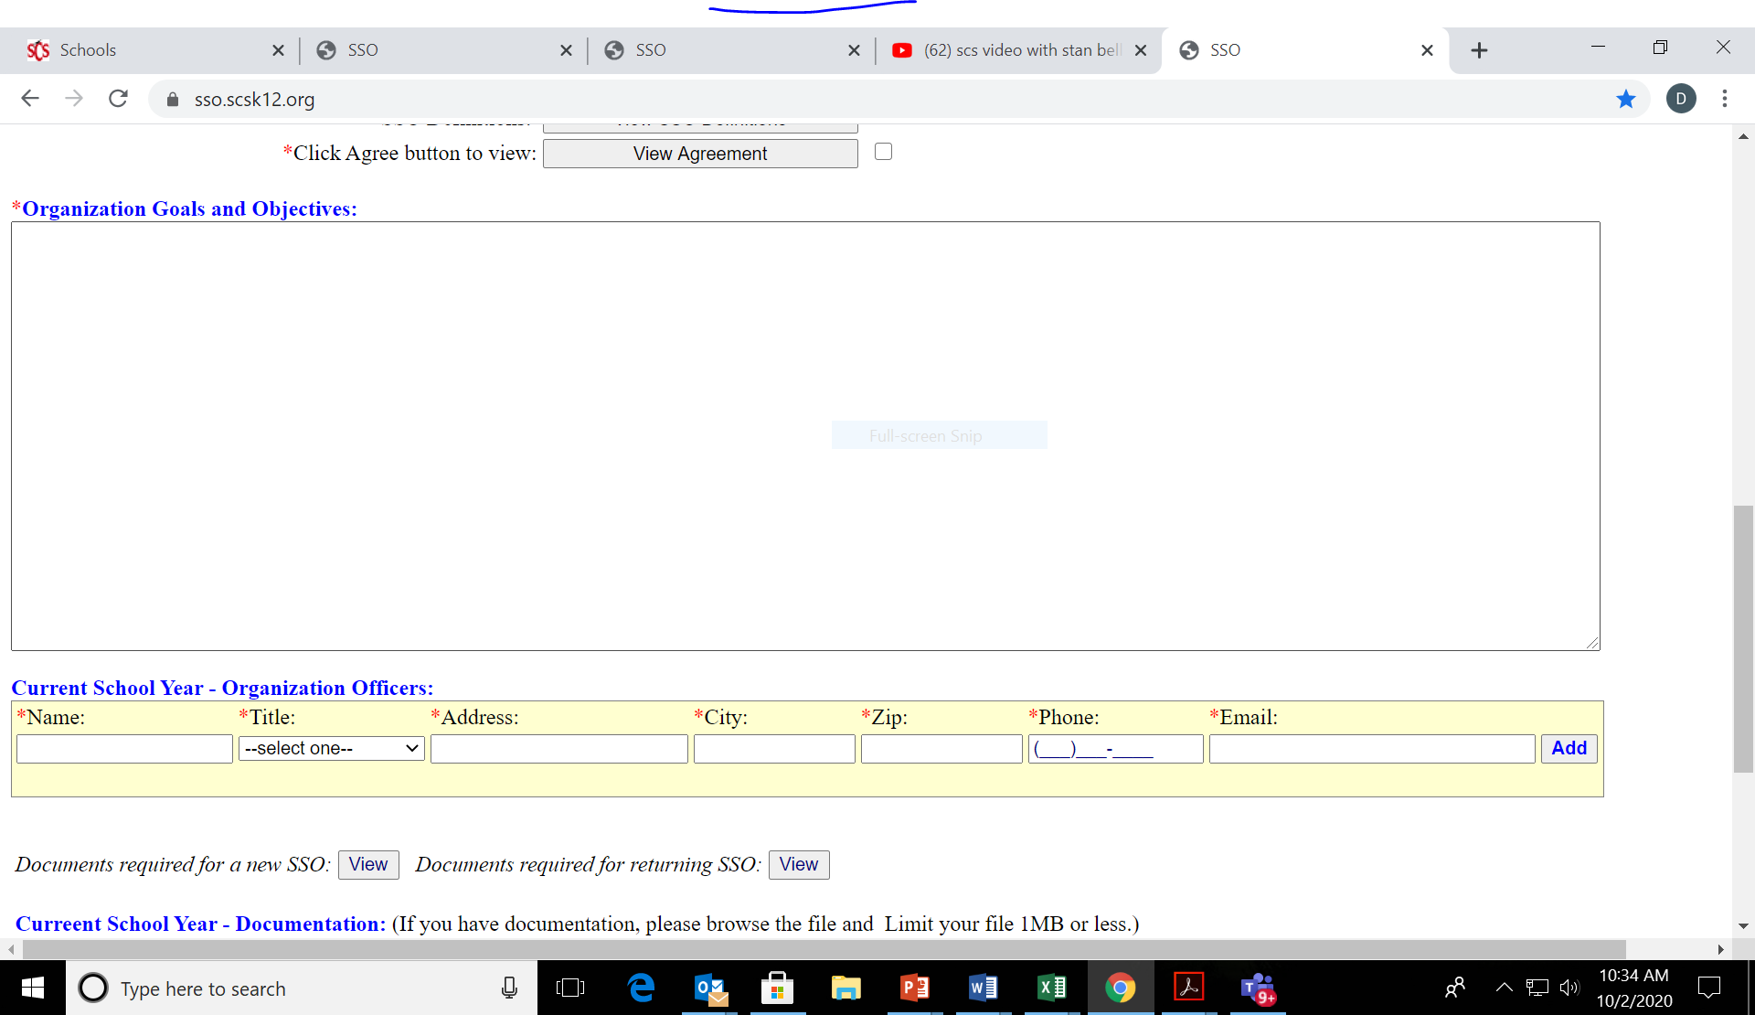

Slide 29
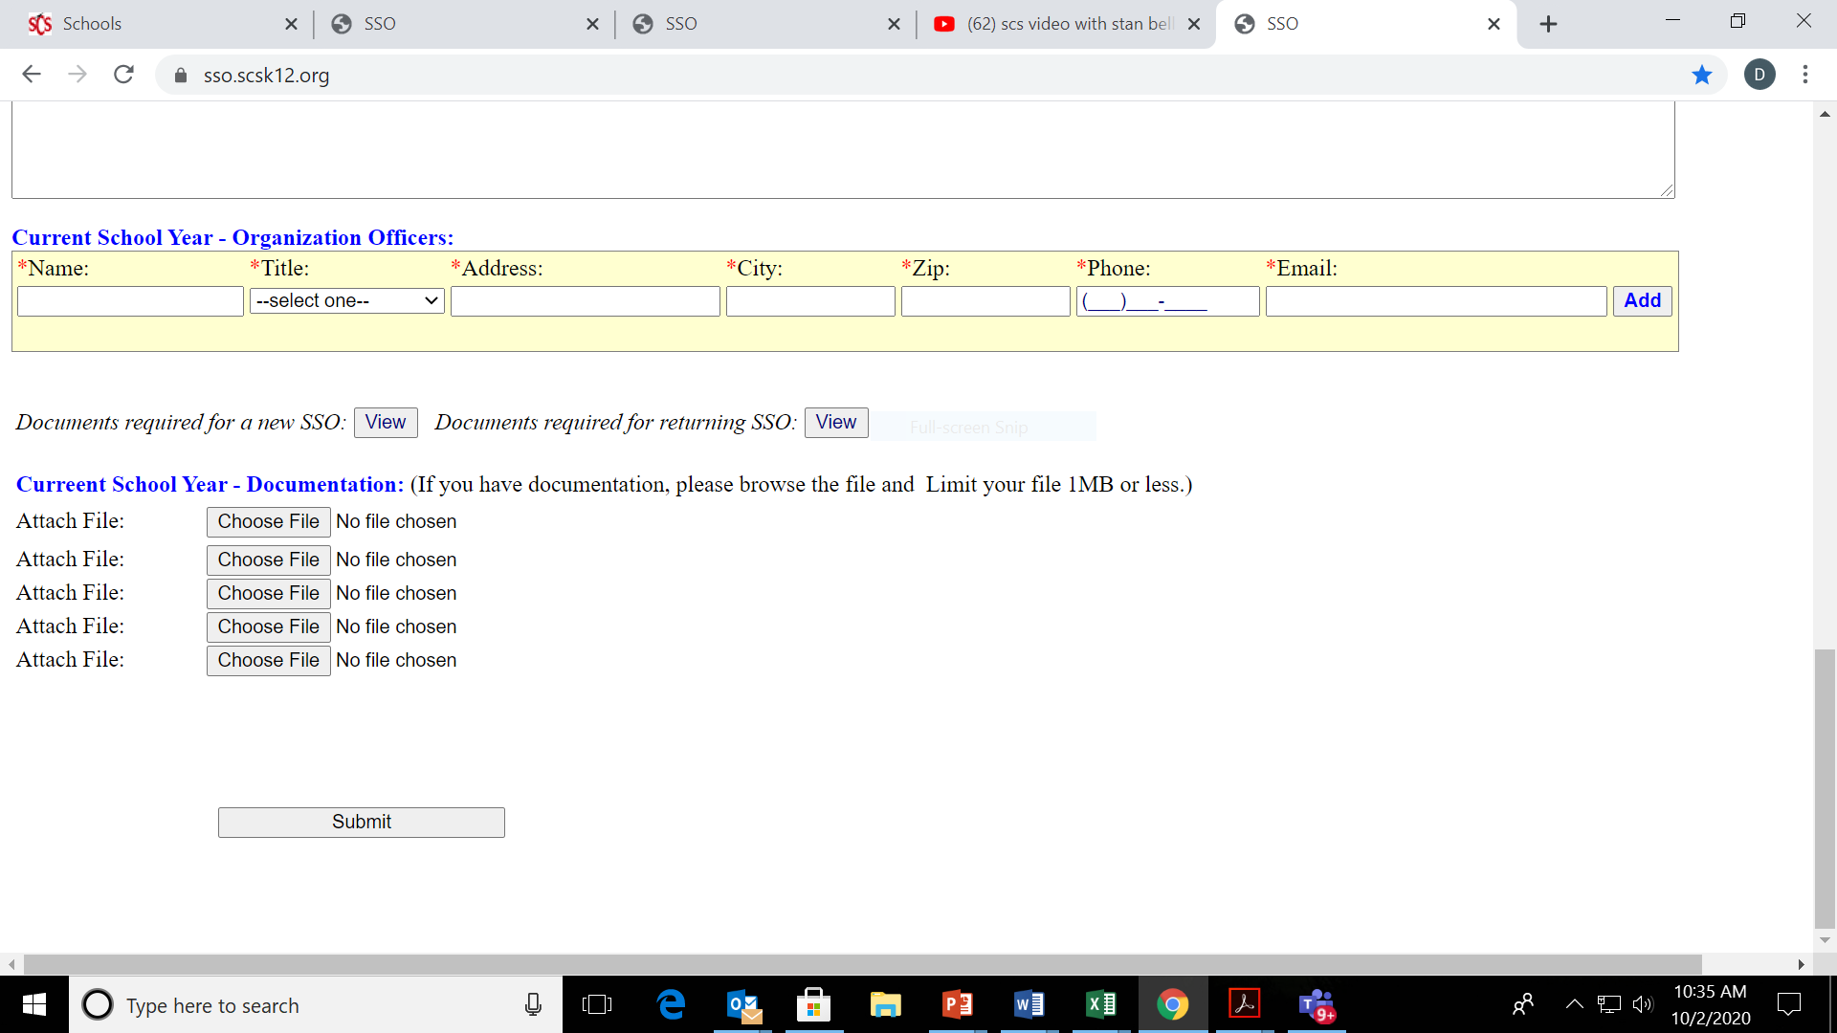

Slide 30
FACE Contact Information
Address: 160 S. Hollywood St, Rm 164
Phone: 416-7600
Website: http://www.scsk12.org/face/
Email: scsface@scsk12.org
Social Media:
@EmpowerSCS
@FACESCS
@FACESCS

Slide 31
Registration Period for Parent Organizations
July 1-September 30

