Slide 2
What Guides Us
Policy 2006
Requirements for Written Contracts are Required
Requirements for Board Approval
Signature Authority
Policy 2012
Requirements for a formal Procurement
Policy 2013
Special Requirements for Professional Services

Slide 3
Requirements for Written Contracts
Real Estate | No Cost Contracts involving Liability
Construction, Repairs, Maintenance | Charter School Agreements
Use of SCS Facilities | Equipment Leases (but not short-term rentals)
Non-professional Services on SCS premises | Professional Services
Sponsorships, Grants, Donations | Revenue
Master Contracts | Software (but not off-the-shelf)
Equipment Purchases requiring installation on SCS premises | Intergovernmental Agreements
Memoranda of Understanding | Memoranda of Agreement

Slide 4
Board Requirements
Board Approval Required
Contracts Valued at $100,000 and above
Real Estate transfers (sale or lease)
Sponsorships that are exclusive and Naming Rights Agreements
Contracts for term longer than a year
Board Notification
Contracts valued between $25,000 and $99,999

Slide 5
Board Requirements, Cont’d
Information Required to Submit Contracts to the Board
District Goal Served
Measurable Outcomes Expected
Cost for previous three years, where applicable
Explanation of expected benefits
Other Options for Addressing the Need
Sustainability Plan
Implementation Plan
Adverse Impact on students or District if not approved at level requested
Number and Description of Staff positions to be created, where applicable

Slide 6
How to Initiate
Enter an Electronic Contract Request
Contract Request Portal (http://155casadap/casadap/req/)
Use the SCS computer username and password to log on
Upload a copy of the proposed contract, if any;
Include APECS requisition number (except for no cost contracts or revenue generating contracts)
Upload all supporting documentation, including, vendor proposals, a detailed description of services to be performed

Slide 7
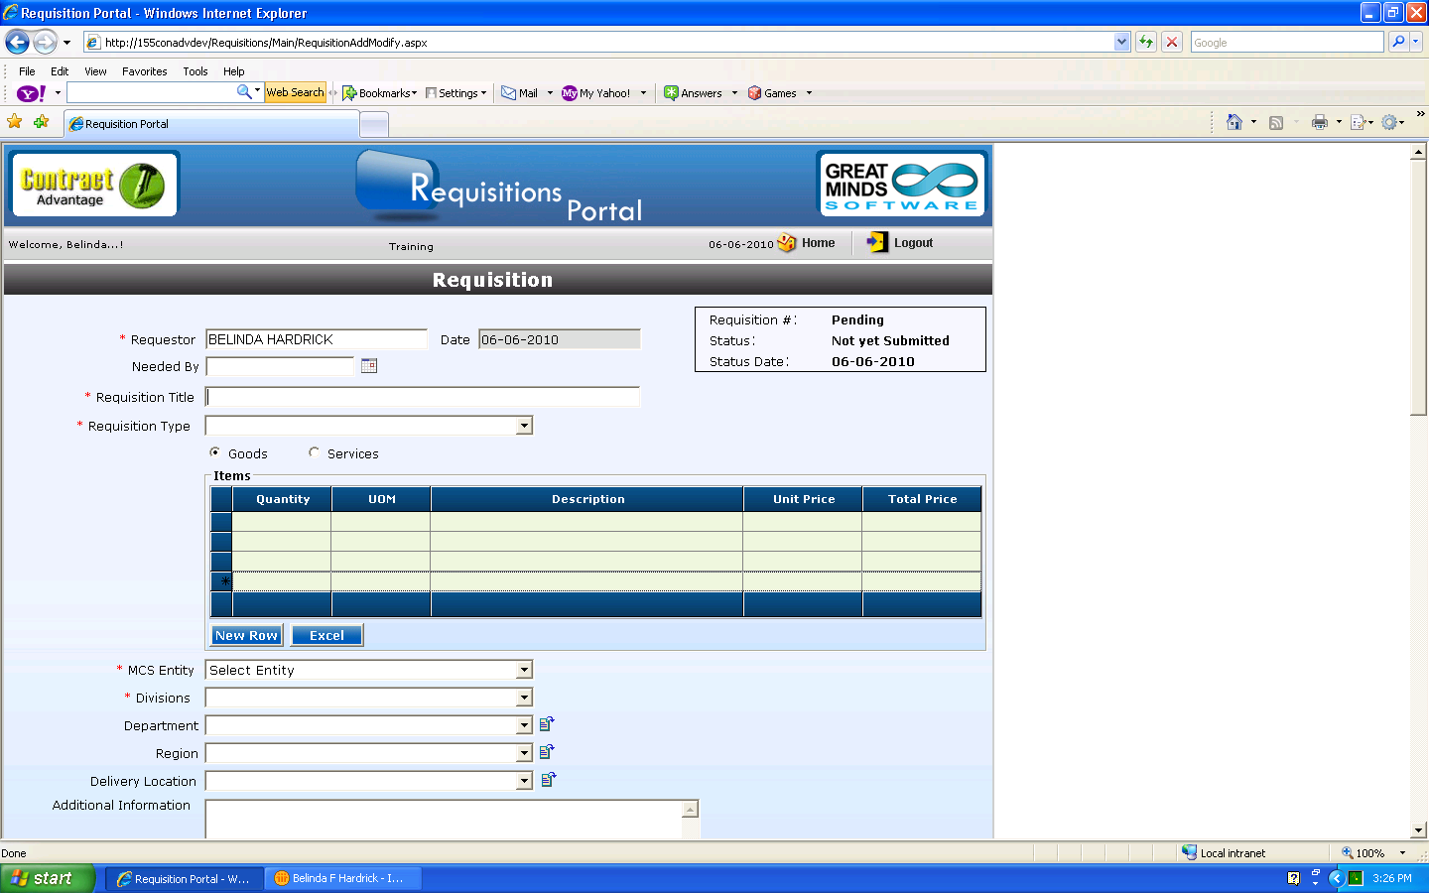
Electronic Requisition

Slide 8
Electronic Requisition, cont’d.

Slide 9
Workflow Approvals
Department approvals per Department instructions
Any number of management levels
Finance personnel
Federal Programs
Dollar limits
Contract Types

Slide 10
Other Department Approvals
Department | Approvals
Information Technology | Software and technology purchases
Facilities | Repairs, maintenance, cabling
Finance | Long-term financial commitments
Federal Programs | Grant funded purchases
Curriculum and Instruction | Curriculum resources
Risk Management | Insurance, Indemnity and Risk Issues
Security | Criminal Background Checks
Community Resources | Use of SCS facilities
Communications | Film requests
Procurement | Bidding issues
General Counsel | Legal liability issues

Slide 11
Signatory Authority
Contract Amount | Contract Initiator | Contract Signer
Up to $5,000 | Principal or Budgetary Manager | Principal or Director or above
$5,001 to $99,999 | Principal or Budgetary Manager | Superintendent
$100,000 or above | Director or above | Superintendent and Board Chairman

Slide 12
School-Based Contracts
Copiers and other equipment leasing
In-School Activities (Tutoring, Mentoring, etc.)
Performances (Magic Shows, Memphis Opera, etc.)
Speakers
Professional Development
After School Activities (Ballet, Karate, Acting, etc.)
Special Activity or Tuition Services (Cheer Coaching, Chess Coaching)
Facility Services (landscaping, painting, charter bus)
Sponsorship/Advertising/Vending
Recreation Rentals (bouncers, Game Truck, etc.)
Senior Class contracts (pictures, rings, yearbooks, etc.)
Web-based software (Assessments, Curriculum Resources, Teacher resources)

Slide 13
Questions and Answers

